Slide 1



SAVING
Author: FRAMEWORK
Notes:
Saving is a fundamental aspect of financial stability and security. In a world where unexpected expenses and emergencies can arise at any moment, having savings provides a safety net and peace of mind. The Saving module is designed to equip women with the knowledge and tools necessary to build and maintain a robust savings plan tailored to their unique circumstances.
Saving goes beyond just setting aside money for a rainy day; it's about creating a foundation for future financial success and freedom. Having savings allows individuals to weather economic downturns, pursue opportunities for personal or professional growth, and achieve long-term goals such as homeownership, education, or retirement. Moreover, saving instills discipline and financial responsibility, fostering a sense of control over one's financial future.
This module emphasizes the significance of saving as a proactive measure for financial security. It aims to empower women to take charge of their financial well-being by cultivating a savings mindset and adopting strategic saving practices. Through education, planning, and consistent effort, women can achieve greater financial resilience and autonomy, paving the way for a more prosperous future.

Slide 2

LEARNING OBJECTIVES
Understand why saving is significant in achieving personal life goals and reaching a financially balanced life, with a focus on the long term;
Knowledge of different main savings instruments;
Understand the circular process between earning, budgeting, saving, investment and retirement;
Understand what inflation is, and how it affects your savings; the concept of money depreciation and purchase power. Differences between nominal and real value. How the purchasing power has been modified during the last years. How money depreciation affects the retirement plan and the pension's real value.
Notes:
The goals of the module are the following:
Understand why saving is significant in achieving personal life goals and reaching a financially balanced life, with a focus on the long term;
Knowledge of different main savings instruments;
Understand the circular process between earning, budgeting, saving, investment and retirement;
Understand what inflation is, and how it affects your savings; the concept of money depreciation and purchase power. Differences between nominal and real value. How the purchasing power has been modified during the last years. How money depreciation affects the retirement plan and the pension's real value.

Slide 3

INTRODUCTION
In time of high inflation is essential for women to understand how to maintain purchasing power, to reach personal financial goals.
Notes:
In today's volatile economy, building a robust savings account stands out as a crucial step in taking control of your financial well-being. The last thing anyone wants is to constantly worry about being just a paycheck or two away from financial turmoil due to unforeseen circumstances. These can range from job loss and disability to unexpected expenses like car repairs, medical emergencies, or caring for a sick loved one, putting immense strain on finances. By accumulating savings, individuals create a financial safety net, offering a sense of security and tranquility amidst life's uncertainties.
Establishing an adequate emergency fund serves as a vital shield against unexpected financial shocks, allowing individuals to navigate through tough times without resorting to debt or sacrificing their financial stability. Moreover, once this foundation is laid, savings can serve as the cornerstone for venturing into higher-yielding investment opportunities, such as stocks, bonds, or mutual funds, further strengthening financial resilience and potential growth (GGI Insights, 2024).
Furthermore, recent research from Northwestern Mutual underscores the connection between savings and overall happiness. The study reveals that individuals who engage in proactive financial planning, including setting goals and taking concrete steps like saving money, tend to experience higher levels of happiness and satisfaction with their lives compared to those who lack such plans. Additionally, findings from the Consumer Federation of America emphasize the importance of having spending and saving plans, especially for individuals with lower incomes. Those who adhere to structured financial plans with clear goals are significantly more likely to have emergency funds set aside, providing further evidence of the positive impact of intentional financial management on overall financial well-being (O´Neill, 2009).
Economists and psychologists attribute findings like these to the sense of control that people have when they plan and know what they need to do to get from where they are now to where they want to be. It is well established by research that people who feel a sense of control over life events are often happier, cope better, and are more resilient in times of stress than others. Conversely, people are especially unhappy in situations where they perceive themselves to have a lack of control. It is, therefore, no surprise that commuting ranks high on the list of things that make people most unhappy. Commuters never know from day to day what traffic gridlock, accidents, and weather-related hassles they’ll encounter (O´Neill, 2009).

Slide 4

SAVING
WHY SAVING IS IMPORTANT
Create an emergency fund
Pay off our debts
Invest
Paying for your children’s education
Ensuring a good old age
Having financial stability
Notes:
Understanding the purpose behind saving makes the process significantly easier. It facilitates better management of unforeseen circumstances, providing enhanced financial stability. Moreover, saving contributes to overall well-being and aids in the accomplishment of specific life goals. It's important to recognize that savings can be allocated towards multiple objectives simultaneously.
Here are seven simple reasons why saving money is important (MAPFRE 2023):
Establishing an Emergency Fund: Individuals can save up enough money to cover their expenses for three to six months. This helps if something unexpected happens, like losing a job or needing to fix something urgent at home.
Debt Repayment: Saving some money from one's income can help in paying off debts faster. Starting with the ones that charge the most interest allows individuals to save money on interest payments in the long run.
Investment Opportunities: Saving money can lead to investing, wherein individuals put their money into things that can make more money over time. Even starting with small and safe investments can grow one's money in the long term.
Fulfilling Travel Dreams: Saving money can assist individuals in achieving their travel dreams. Having some extra cash for trips, whether it's a weekend getaway or a road trip, can enhance one's travel experiences.
Investing in Education: Saving money can be directed towards personal or children's education. Education is crucial for a good future, and having savings can make it easier to afford quality education.
Securing Retirement: Saving money now can contribute to a comfortable retirement later in life. Consistently setting aside funds can accumulate over time, providing peace of mind during retirement years.
Attaining Financial Stability: Saving money not only helps individuals plan for the future but also gives them a sense of security. It offers more freedom to pursue personal goals and handle unexpected expenses.
Common situations where saving becomes vital can be grouped into four main categories:
Short-term goals: Many individuals save up for short-term goals, such as purchasing a car or going on a vacation. These are things they want to achieve within a relatively short time frame, typically within a year or two.
Medium-term goals: Saving for medium-term goals involves setting aside money for objectives that might take a bit longer to achieve, like saving for a down payment on a house. These goals usually span a few years and require consistent saving efforts.
Long-term goals: Planning for retirement is perhaps one of the most critical long-term goals individuals should save for. Encouraging individuals to start saving early for retirement ensures financial security in later years when they may no longer be working.
Rainy day fund: Means having an emergency fund for unexpected expenses. This fund acts as a safety net during challenging times, such as medical emergencies or unexpected home repairs.

Slide 5
SAVING
TIPS AND STRATEGIES TO IMPROVE SAVING
Start keeping a record of your expenses
Minimize your expenses
Set a monthly budget
Pay yourself first
Start Small
Create an account for saving and automate your savings.
Notes:
Once you've clarified why you want to save, the next step is determining how to do so effectively. Here are five practical tips to boost your savings:
Track Your Expenses: Keeping a detailed record of all expenses is crucial, whether through your bank's app, specialized software, or simply using pen and paper. This insight helps identify areas for trimming, including every coffee, newspaper, or snack purchase throughout the month, along with fixed expenses like gas, groceries, and mortgage payments.
Cut Unnecessary Spending: After documenting expenses, pinpoint non-essential categories ripe for reduction. Cancel unused subscriptions, curb impulsive purchases, and scrutinize utility bills for potential savings. Comparison shopping can also yield significant savings on everything from groceries to utilities.
Establish a Monthly Budget: Craft a realistic budget based on insights from expense tracking. The popular 50-30-20 rule allocates income into fixed expenses, variable expenses, and savings. Even if starting with a lower percentage, forming the habit of saving is key. Adjust the percentages over time to align with your financial goals, including regular but non-monthly expenses like car maintenance check-ups.
Segregate Your Savings: Create a dedicated savings account to separate funds earmarked for future use. This separation helps discourage dipping into savings for non-essentials, fostering disciplined saving habits. Plan your savings by allocating a percentage of your income within your budget, aiming for at least 15%. If necessary, cut back on non-essentials like entertainment and dining out before reducing spending on essentials like transportation or housing.
Set Saving Goals: Establishing saving goals makes it easier to get started. Decide the timeline for each goal and prioritize them based on personal preferences. Implement the "pay yourself first" approach by allocating a percentage of your income—such as 15% or 20%—toward savings on the first of each month. This proactive strategy ensures consistent saving and encourages living within your means.

Slide 6
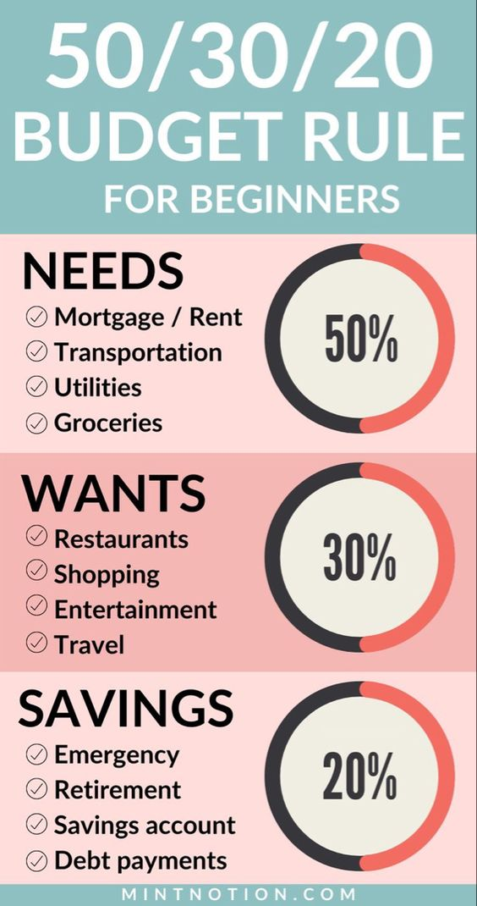
SAVING
A SIMPLE RULE FOR A DAILY SAVING PLAN
Notes:
The universal appeal of the 50/30/20 rule is its simplicity. If you want to know how much of your salary you should save, or what percentage of your income you should allocate to housing or food expenses, the 50/30/20 rule will help you. It divides all outputs into three simple categories.
50% for necessities / 50% of your salary should be spent on essentials such as rent, bills, transportation, and food. These are things that cannot be done without. They are essential things.
30% for desires / 30% should be spent on leisure activities and hobbies, such as gym membership, holidays or buying takeaway food on Fridays, when you are completely exhausted. These are all things that are desired but not necessary for survival.
20% for savings / The last 20% of your salary should be put towards savings or paying off any debts, such as credit cards or student loans.

Slide 7
SAVING
A SIMPLE EXERCISE FOR A REAL SAVING PLAN
1. Write down the goal you're saving toward.
2. Figure out the total amount you need to save to reach that goal.
3. Decide how many weeks you have to save.
4. Divide the total amount by the number of weeks. That is your savings target.
5. Think about ways you can cut expenses to match the total amount you need to save per week.
Notes:
1. Write down the goal you're saving toward.
2. Figure out the total amount you need to save to reach that goal.
3. Decide how many weeks you have to save.
4. Divide the total amount by the number of weeks. That is your savings target.
5. Think about ways you can cut expenses to match the total amount you need to save per week.

Slide 8
SAVING
THE EMERGENCY FUND
It’s a financial safety net you can rely on when unexpected expenses or life events occur
An emergency fund is a crucial component of a healthy financial plan.
Notes:
An emergency fund is a financial safety net you can rely on when unexpected expenses or life events occur. Emergencies can include a sudden job loss, medical expenses, home repairs, car repairs and more. By having an emergency fund, you can avoid going into debt or dipping into other savings, kid’s college fund. An emergency fund is a crucial component of a healthy financial plan.
Why Do You Need Emergency Funds?
Financial Security: Ensures a sense of stability during unexpected financial setbacks.
Avoiding Debt: Helps avoid reliance on credit cards or loans with high-interest rates.
Peace of Mind: Reduces stress by knowing you're financially prepared for emergencies.
Financial Independence: Allows autonomy without relying on others during tough times.
The amount of money you should have in your emergency fund can vary depending on your personal and financial goals. As a rule of thumb, financial experts recommend having enough savings to cover three to six months’ worth of living expenses.
If you have a stable job with a regular income, you may be able to get by with three months’ worth of living expenses. However, if you have a more volatile income or are self-employed, you may want to aim for six months’ worth or more.
Other factors to consider include your level of debt, any dependents you have, and your overall financial goals. For example, if you’re planning to purchase a home, launch a business or start a family shortly, you may want to save more aggressively to build up your emergency fund.

Slide 9
SAVING
CALCULATION OF AN EMERGENCY FUND
Determine the right amount for your emergency fund by calculating your monthly expenses ((including mortgage or rent payment, utilities, transportation, food, medical, non-mortgage debt payments, childcare, education, child support and alimony, and other essential expenses;
Evaluate your personal/family financial risk;
Multiply your monthly expenses from 3 to 6 times.
Notes:
Calculating your emergency fund can be broken down into a few simple steps. Here’s how to get started.
1. Calculate Your Monthly Expenses
Determine the right amount for your emergency fund by calculating your monthly expenses. This includes rent or mortgage payments, utilities, groceries, transportation, insurance premiums and any other recurring bills. Multiply this total by the number of months you would like to have covered by your emergency fund.
For example, if your monthly expenses (including mortgage or rent payment, utilities, transportation, food, medical, non-mortgage debt payments, childcare, education, child support and alimony, and other essential expenses) are € 3,000 and you want to save for three months, your emergency fund goal would be € 9,000.
2. Evaluate Your Risk Factors
Next, evaluate your risk factors. If you have a stable job and income, you may be able to get by with a smaller emergency fund. However, if your income is unpredictable or you work in a volatile industry, you may need to save more. Additionally, if you have dependents, a mortgage or other financial obligations, you may need to save more to cover your expenses.
3. Consider Your Comfort Level
Finally, consider your comfort level. How much of a safety net do you need to feel financially secure? If it’s a standard three- to six-month emergency fund, that’s great. Make that your goal. But if your life obligations still leave you feeling vulnerable, up your emergency fund to an amount that feels right for you.
Building an emergency fund is a vital step toward financial stability and peace of mind. Tailoring personal savings strategy to the unique circumstances and goals is a way to ensure lasting financial security.

Slide 10

SAVING
EVALUATING THE COMMON SAVING TOOLS
Checking accounts VS Saving Accounts
A savings account is a deposit account that can be used to hold money you don’t plan to spend right away. Most savings accounts pay interest on deposits, though the interest rate and annual percentage yield (APY) can vary significantly from bank to bank.
Notes:
A savings account is a deposit account that can be used to hold money you don’t plan to spend right away. Most savings accounts pay interest on deposits, though the interest rate and annual percentage yield (APY) can vary significantly from bank to bank.

Slide 11

INFLATION
Inflation measures how much more expensive a set of goods and services has become over a certain period, usually a year
Notes:
Inflation measures how much more expensive a set of goods and services has become over a certain period, usually a year

Slide 12

PURCHASING POWER
Purchasing power is the value of a currency expressed in terms of the number of goods or services that one unit of money can buy. It can weaken over time due to inflation. That's because rising prices effectively decrease the number of goods or services you can buy. Purchasing power is also known as a currency's buying power.
Notes:
Purchasing power is the value of a currency expressed in terms of the number of goods or services that one unit of money can buy. It can weaken over time due to inflation. That's because rising prices effectively decrease the number of goods or services you can buy. Purchasing power is also known as a currency's buying power.

Slide 13
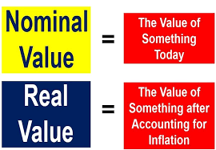
PURCHASING POWER
Notes:
"Nominal" and "real" are fundamental economic terms that impact various aspects of our financial lives, from loans to salaries to GDP growth. Let's delve into what these terms mean and why understanding them is crucial.
Consider this scenario: You've held onto 5 euros in your wallet for a decade. Initially, that amount could cover a newspaper, coffee, or bus fare, with some money left over. Fast forward to today, and those 5 euros likely won't stretch as far. Why? Because while the nominal value remains 5 euros, its real value (what you can actually buy with it) changes due to factors like inflation.
Unlike real value, nominal value doesn't account for market conditions. In economics, nominal value reflects current prices, while real value reflects prices over time.
Both terms are applicable not only to money but also to wages, stock prices, and other financial assets. For instance, if you earn a nominal salary of 2,000 euros monthly and inflation is at 4% for the year, your real purchasing power diminishes. Adjusted for inflation, your 2,000 euros now equate to 1,920 euros, resulting in a decrease in your purchasing power relative to a base year. Understanding nominal and real values helps gauge the true worth of financial assets amid changing economic conditions.
Nominal and real values also apply to:
Interest
Interest encompasses both the cost of borrowing money from a bank and the return on your savings or investments. When you invest in a fund, the agreed-upon rate of return represents the nominal interest rate. However, the real interest rate considers additional factors such as fees, expenses, taxes, and inflation. For instance, if you invest €100 at a nominal interest rate of 3% per year, you'd have €103 by year-end. Yet, with inflation at 2%, your investment's real interest rate would only be 1% (nominal interest minus inflation).
GDP
Gross domestic product (GDP) serves as a key indicator of economic development, reflecting the monetary value of goods and services produced within a country or region over a specified period. Nominal GDP relies on current market prices, but inflation-induced price hikes can inflate it, even if actual output remains unchanged.
Real GDP, on the other hand, adjusts for inflation, providing a more accurate assessment of output's relative value over time. It is calculated using a base year's prices and a GDP price deflator formula to express nominal output in real terms. Real GDP helps determine whether production capacity has expanded or contracted, irrespective of market price fluctuations.
Understanding the distinction between nominal and real values empowers better financial decision-making when interpreting bank statements, returns reports, and financial news.

Slide 14
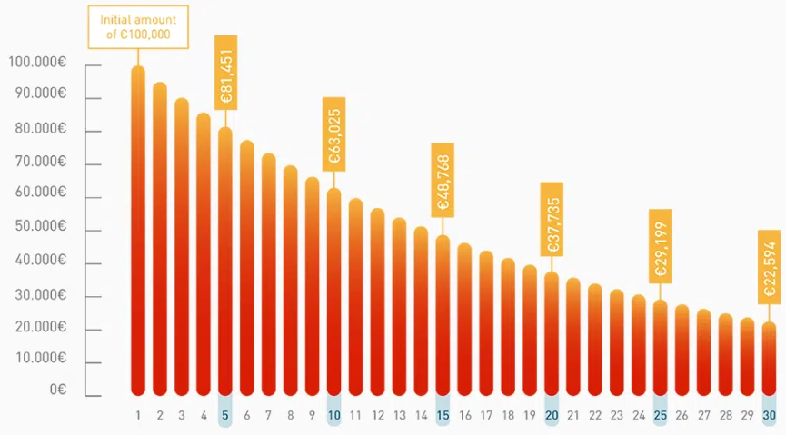
PURCHASING POWER
Try the quick calculator of the purchasing power compare prices among different years.

Slide 15

INFLATION AND PENSION
Inflation may impact your financial situation and reduce your purchasing power now and in the long term. Take time to consider your options before taking important decisions on your insurance and private pension products (e.g.: temporarily stop paying in contributions to your pension or your regular premium life insurance product, not renewing an insurance product or terminating your insurance-based investment product early), because these decisions can also impact your financial situation now and in the future.

Slide 16

INFLATION AND PENSION
Here are some easy advice to give the appropriate awareness that can easily improve the behaviour.
- For all types of insurance products and private pensions, avoid taking hasty decisions.
- For life insurance products and private pensions, adopt a long-term perspective.
Notes:
Here are some easy advice to give the appropriate awareness that can easily improve the behaviour.
- For all types of insurance products and private pensions, avoid taking hasty decisions.
- For life insurance products and private pensions, adopt a long-term perspective.

Slide 17
INFLATION AND PENSION
FOCUS ON PRIVATE PENSION
With a personal pension you pay regular monthly amounts or a lump sum to a pension provider who invests it on your behalf. Other people and family members can pay a personal pension on your behalf. Some employers set up group personal pensions for their employees.
Your decision depends on how much you can afford to save for your pension and how much you will get from other pensions.
A personal pension may be suitable for you if:
you are self-employed and don't have access to a workplace pension
you aren't working but can afford to pay into a pension
you want to save more for retirement
your employer offers it as a workplace pension scheme
Stakeholder pensions
Notes:
With a personal pension you pay regular monthly amounts or a lump sum to a pension provider who invests it on your behalf. Other people and family members can pay a personal pension on your behalf. Some employers set up group personal pensions for their employees.
Your decision depends on how much you can afford to save for your pension and how much you will get from other pensions.
A personal pension may be suitable for you if:
you are self-employed and don't have access to a workplace pension
you aren't working but can afford to pay into a pension
you want to save more for retirement
your employer offers it as a workplace pension scheme
Stakeholder pensions

Slide 18


Thank you!
Project Number: 2022-1-AT01-KA220-ADU-000087985
Notes:
In conclusion, this module underscores the critical role of savings in achieving financial stability and security. Beyond merely setting aside funds for emergencies, saving serves as a cornerstone for future financial success and freedom. This module can equip women with the knowledge and tools needed to build and maintain a robust savings plan tailored to their unique circumstances. By instilling discipline and financial responsibility, saving empowers individuals to weather economic challenges, pursue personal and professional opportunities, and achieve long-term goals such as homeownership, education, or retirement. Through education, planning, and consistent effort, women can cultivate a savings mindset and adopt strategic saving practices, thereby enhancing their financial resilience and autonomy for a more prosperous future.

